Slide 1
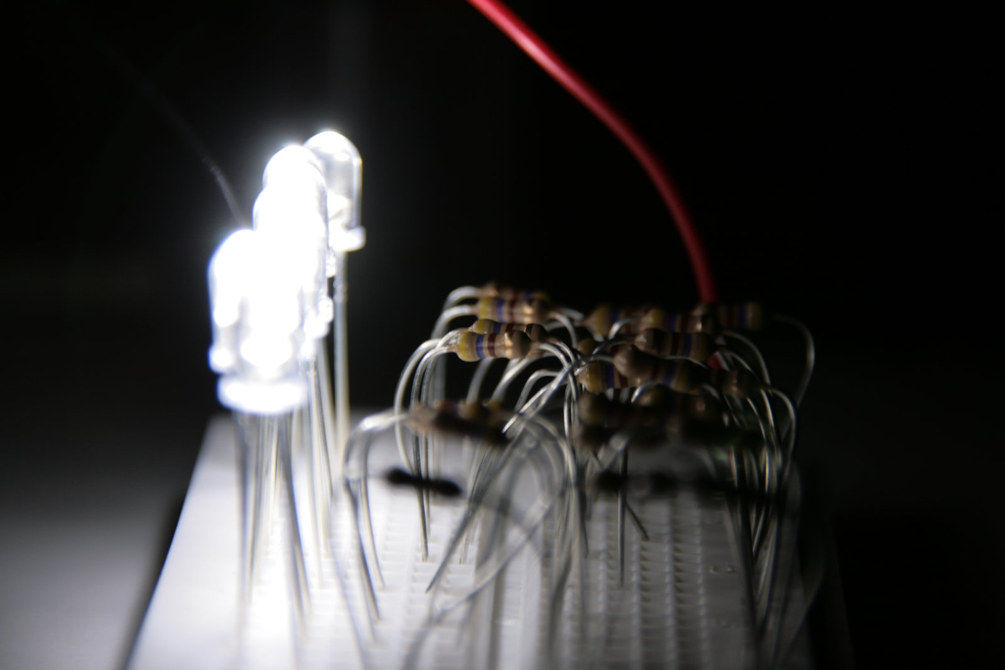
Workshop electronics & arduino
Start 9u30

Slide 2

Les 3 : grote vermogens en fun fun fun

Slide 3
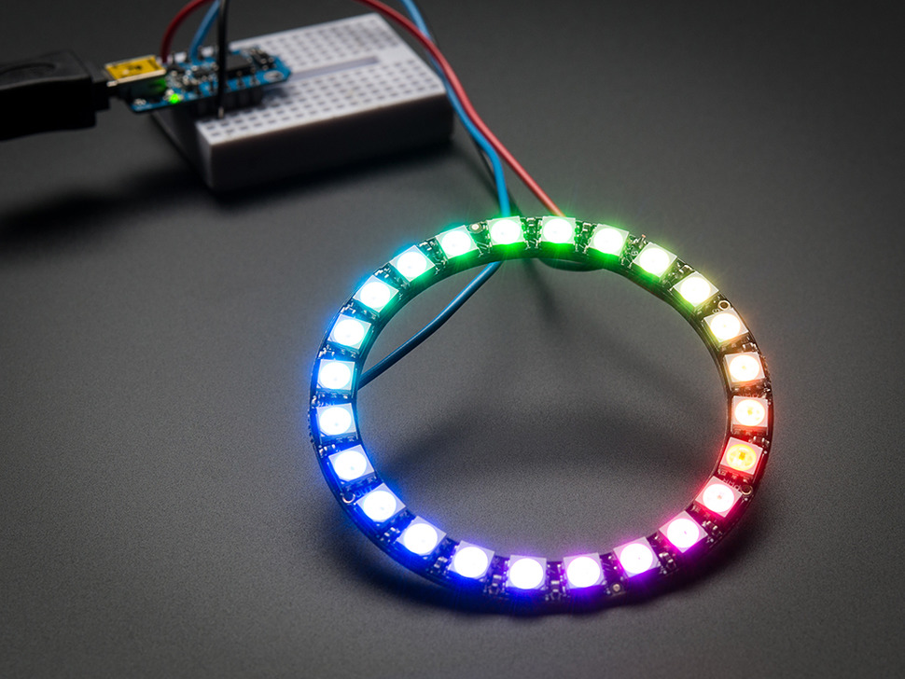
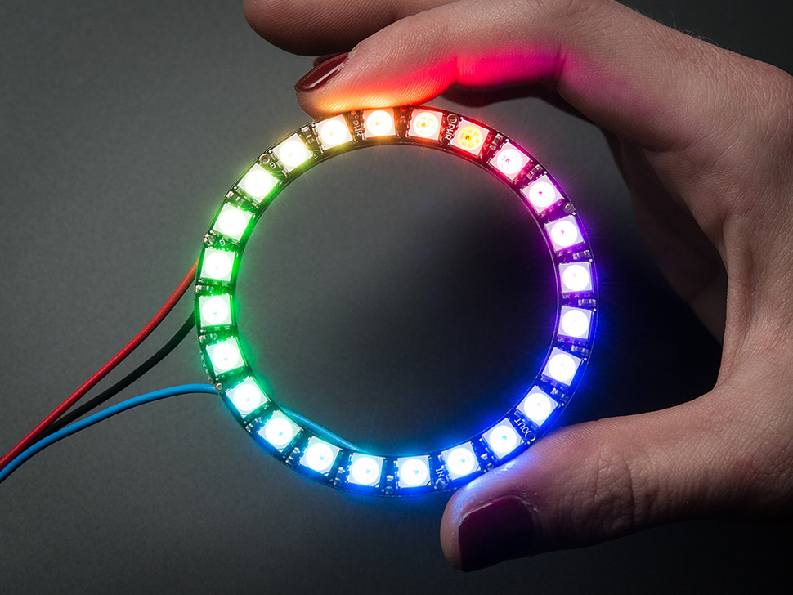
Neopixel ring
http://www.adafruit.com/product/1586

Slide 4
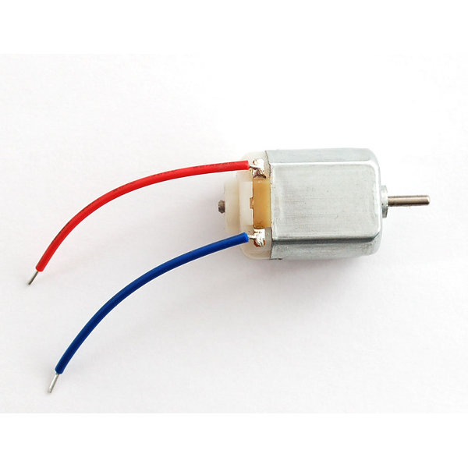
DC motor

Slide 5
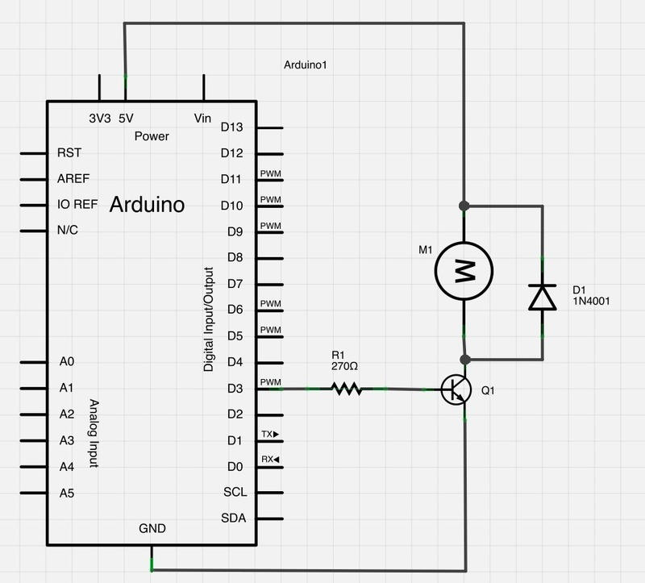
Transistors
https://learn.adafruit.com/adafruit-arduino-lesson-13-dc-motors

Slide 6
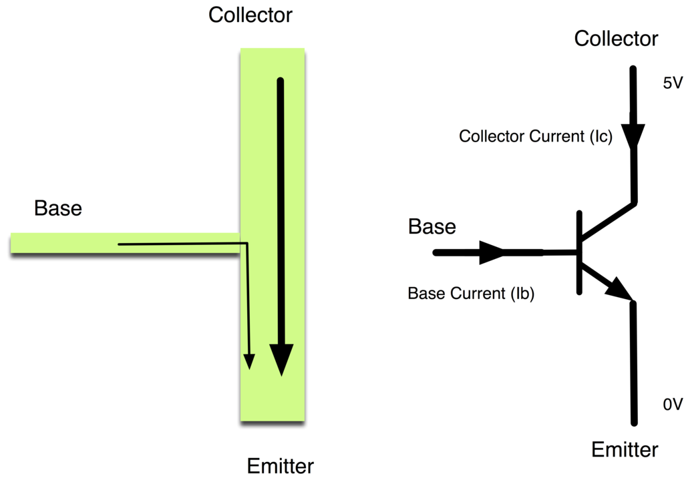

Slide 7
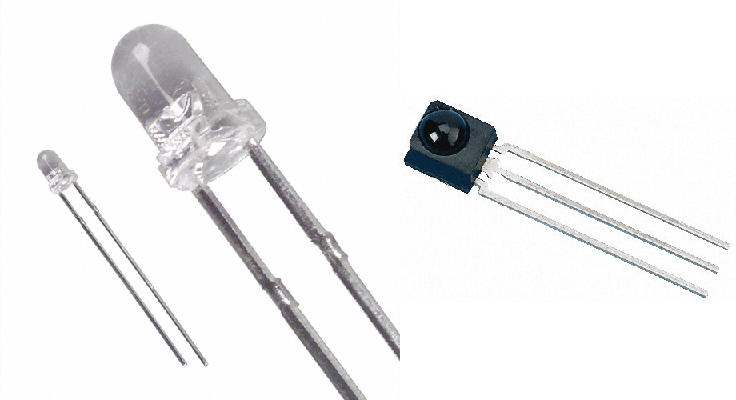
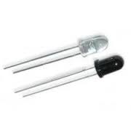
IR Led – IR receiver
http://www.righto.com/2009/08/multi-protocol-infrared-remote-library.html

Slide 8
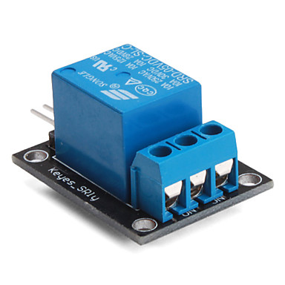
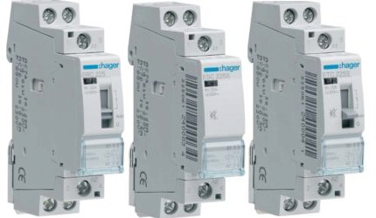
Relais

Slide 9
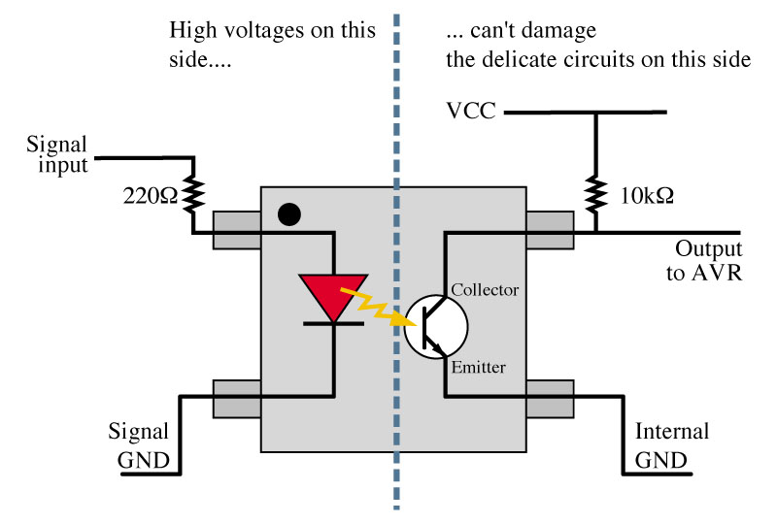
Optocouplers

Slide 10
